Slide 1
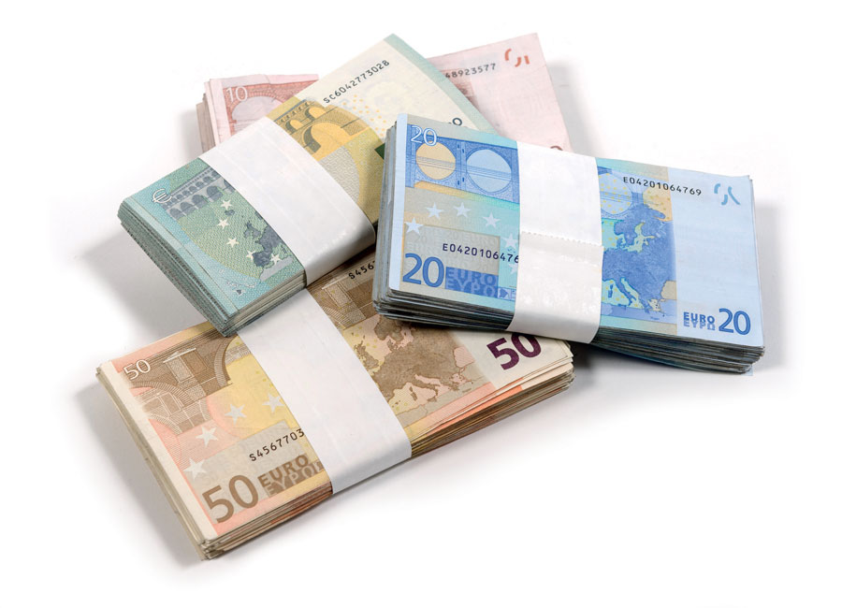

Money talks: the effect of a pay rise on local politicians’ quality
Augusto Cerqua, Samuel Nocito & Gabriele Pinto
DISSE- Sapienza University of Rome
European Public Choice Society, Hannover, 25/03/2023
Cerqua, Nocito & Pinto
Money talks: the effect of a pay rise on local politicians’ quality

Slide 2
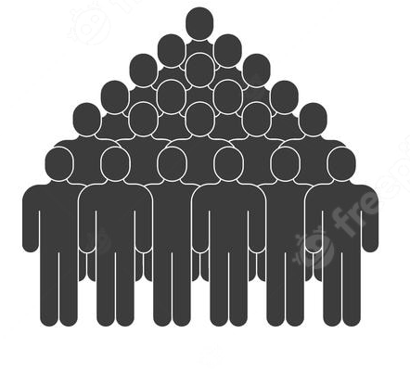
Why should we pay politicians?
Population
Cerqua, Nocito & Pinto
Money talks: the effect of a pay rise on local politicians’ quality

Slide 3

Why should we pay politicians?
Population
The good
Cerqua, Nocito & Pinto
Money talks: the effect of a pay rise on local politicians’ quality

Slide 4
Why should we pay politicians?
Population
The good
The bad
Cerqua, Nocito & Pinto
Money talks: the effect of a pay rise on local politicians’ quality

Slide 5
Why should we pay politicians?
Population
To attract “better” politicians (selection)
The good
The bad
Cerqua, Nocito & Pinto
Money talks: the effect of a pay rise on local politicians’ quality

Slide 6
Why should we pay politicians?
Population
To attract “better” politicians (selection)
To provide them with proper monetary incentive to work (and to do it well).
The good
The bad
Cerqua, Nocito & Pinto
Money talks: the effect of a pay rise on local politicians’ quality

Slide 7
Why should we pay politicians?
Population
To attract “better” politicians (selection)
To provide them with proper monetary incentive to work (and to do it well).
But, does it work?
The good
The bad
Cerqua, Nocito & Pinto
Money talks: the effect of a pay rise on local politicians’ quality

Slide 8
The paper in a nutshell
We evaluate the effect of a large scale reform that increased salary of mayors
Data
  electoral results, education and characteristics of candidates (from the Ministry of Interior)
Cerqua, Nocito & Pinto
Money talks: the effect of a pay rise on local politicians’ quality

Slide 9
The paper in a nutshell
We evaluate the effect of a large scale reform that increased salary of mayors
Data
  electoral results, education and characteristics of candidates (from the Ministry of Interior)
Research Design
  Diff-in-Disc
    before and after the reform
    Above/below 5000 population treshold
  Exact Matching – Diff in Diff
    Same population and same region municipalities
    Municipalities that had (randomly) election before or after the reform
    We look at the effect in ALL municipalities (and not only at the 5k treshold)
Cerqua, Nocito & Pinto
Money talks: the effect of a pay rise on local politicians’ quality

Slide 10
The paper in a nutshell
We evaluate the effect of a large scale reform that increased salary of mayors
Data
  electoral results, education and characteristics of candidates (from the Ministry of Interior)
Research Design
  Diff-in-Disc
    before and after the reform
    Above/below 5000 population treshold
  Exact Matching – Diff in Diff
    Same population and same region municipalities
    Municipalities that had (randomly) election before or after the reform
    We look at the effect in ALL municipalities (and not only at the 5k treshold)
Outcome variables
  Competition (more candidates, margin of victory & HHI)
  Quality (dummy degree & years of education) for Mayors, executive committe (Assessori) and councillor (consiglieri)
Cerqua, Nocito & Pinto
Money talks: the effect of a pay rise on local politicians’ quality

Slide 11
The paper in a nutshell
We evaluate the effect of a large scale reform that increased salary of mayors
Data
  electoral results, education and characteristics of candidates (from the Ministry of Interior)
Research Design
  Diff-in-Disc
    before and after the reform
    Above/below 5000 population treshold
  Exact Matching – Diff in Diff
    Same population and same region municipalities
    Municipalities that had (randomly) election before or after the reform
    We look at the effect in ALL municipalities (and not only at the 5k treshold)
Outcome variables
  Competition (more candidates, margin of victory & HHI)
  Quality (dummy degree & years of education) for Mayors, executive committe (Assessori) and councillor (consiglieri)
Preliminary Results
  In the Diff-in Disc: Higher salaries -> better educated mayor candidate [LATE]
  In the EM-DID: Higher salaries → better educated ex. Committee [ATE]
  Null results for other outcome (political competition, experience)
Cerqua, Nocito & Pinto
Money talks: the effect of a pay rise on local politicians’ quality

Slide 12

Context…
In the last two decade Italian politicians have «suffered» a number of cuts to their financing, this include:
Cerqua, Nocito & Pinto
Money talks: the effect of a pay rise on local politicians’ quality

Slide 13
Context…
In the last two decade Italian politicians have «suffered» a number of cuts to their financing, this include:
  A 10% reduction of local politicians wage in 2006
  Cut to the public financing of parties and political campaign…
Cerqua, Nocito & Pinto
Money talks: the effect of a pay rise on local politicians’ quality

Slide 14
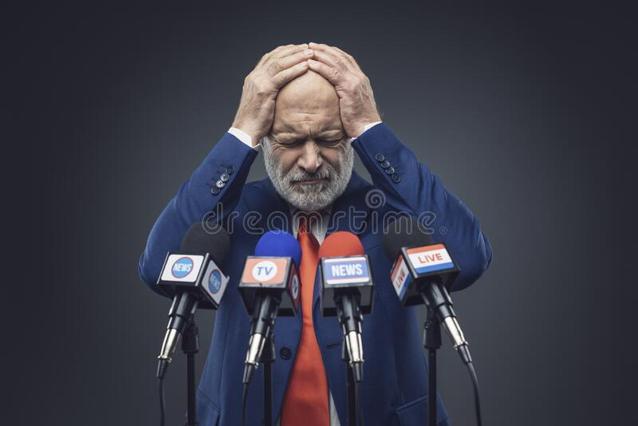

Context…
In the last two decade Italian politicians have «suffered» a number of cuts to their financing, this include:
  A 10% reduction of local politicians wage in 2006
  Cut to the public financing of parties and political campaign…
  …finally, in 2020, the number of national MPs was cut by 1/3 behind the motivation of "saving money“ (55 million € per year)
  (note that this cut was approved by popular acclaim in a referendum)
Cerqua, Nocito & Pinto
Money talks: the effect of a pay rise on local politicians’ quality

Slide 15
…at the end of 2021, a law was passed to increase (~ +55%) the wage of politicians of local administration (e.g. municipalities).
Cerqua, Nocito & Pinto
Money talks: the effect of a pay rise on local politicians’ quality

Slide 16
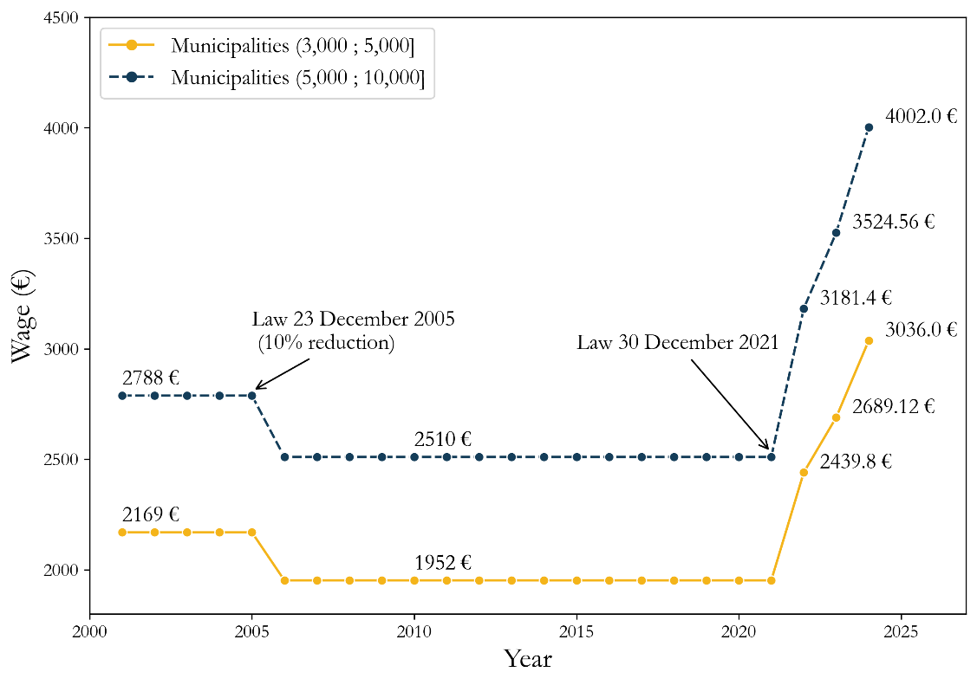
…at the end of 2021, a law was passed to increase (~ +55%) the wage of politicians of local administration (e.g. municipalities).
Politicians Wage (€)
Staggered increase over 2 years (but we do not use it in our identification strategy)
Cerqua, Nocito & Pinto
Money talks: the effect of a pay rise on local politicians’ quality

Slide 17
Motivation - Context
~7000 municipalities, of which ~95% below 20k pop
~Mean Italian wage
Cerqua, Nocito & Pinto
Money talks: the effect of a pay rise on local politicians’ quality

Slide 18
Motivation - Context
~7000 municipalities, of which ~95% below 20k pop
~Mean Italian wage
The whole reform will cost ~200 mln € each year….
Cerqua, Nocito & Pinto
Money talks: the effect of a pay rise on local politicians’ quality

Slide 19
Motivation - Context
Note that only the salary has increased and not the responsibilities!
~7000 municipalities, of which ~95% below 20k pop
~Mean Italian wage
The whole reform will cost ~200 mln € each year….
Cerqua, Nocito & Pinto
Money talks: the effect of a pay rise on local politicians’ quality

Slide 20



How municipality are organized
Ex. Committee (assesori)
Mayor
Councillors (consiglieri)
e.g. city council
Cerqua, Nocito & Pinto
Money talks: the effect of a pay rise on local politicians’ quality

Slide 21
Timing
June 2019 (Alternative Control Period)
No election in 2020
October 2021 (postponed because of Covid) (Control Period)
June 2022 (Treatment period)
Cerqua, Nocito & Pinto
Money talks: the effect of a pay rise on local politicians’ quality

Slide 22



Our contribution
Also compared to Nannacini and Gagliarducci, «Do better paid politicians perform better» (JEEA 2006)
We can test the impact of a Large Scale reform for all municipalities
We update the analysis and the methodology:
  We update the dataset by analysing the most recent local elections (2017-2022 instead 1993-2001)
  Given the new reform adoption, we are able to implement a diff-in-disc analysis (instead of a sharp RDD) by which we can observe differences between municipalities before and after the reform;
  since the reform imposed a sharp increase in wage for local politicians far above the Italian average, we can also focus on the effect of a pay rise on all other local politicians than the mayor.
  Lastly, since the reform increased local politicians’ salaries at all population thresholds, we can exploit an EM-DiD design to estimate the direct short-term effect of the reform within each population threshold.
Cerqua, Nocito & Pinto
Money talks: the effect of a pay rise on local politicians’ quality

Slide 23
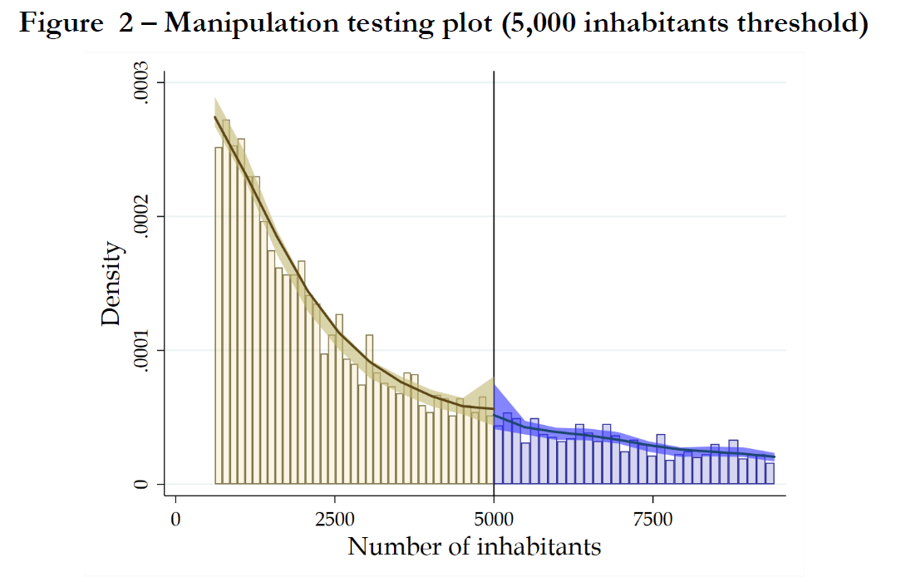
Diff-in-Disc results
Cerqua, Nocito & Pinto
Money talks: the effect of a pay rise on local politicians’ quality

Slide 24
Diff-in-Disc results
Cerqua, Nocito & Pinto
Money talks: the effect of a pay rise on local politicians’ quality

Slide 25
Diff-in-Disc results
…Below and above the treshold both municipalities had a wage increase, but the increase is sligthly different in percentage….(e.g. different inclination)
Cerqua, Nocito & Pinto
Money talks: the effect of a pay rise on local politicians’ quality

Slide 26
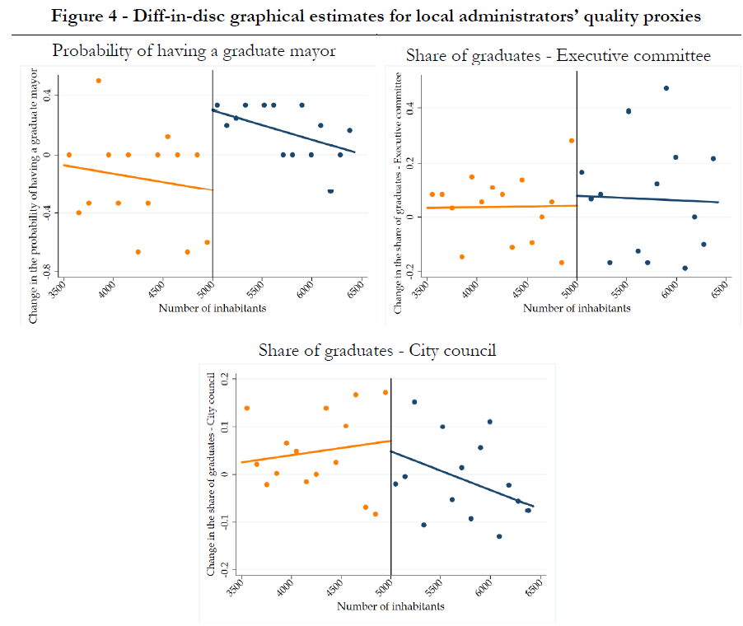
Diff-in-Disc results

Slide 27
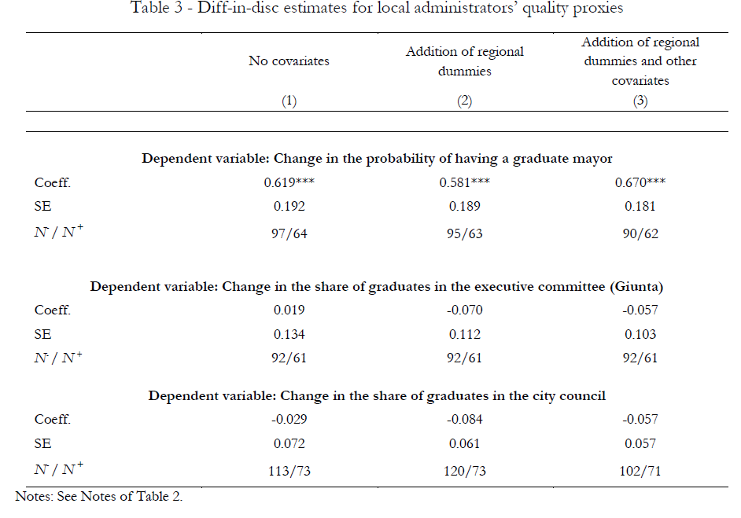
Diff-in-Disc results
Cerqua, Nocito & Pinto
Money talks: the effect of a pay rise on local politicians’ quality

Slide 28
EM-DID results
We have municipality that are in the same region and in the same population size
Here we look at all municipalities (not only at the 5k treshold)
Cerqua, Nocito & Pinto
Money talks: the effect of a pay rise on local politicians’ quality

Slide 29
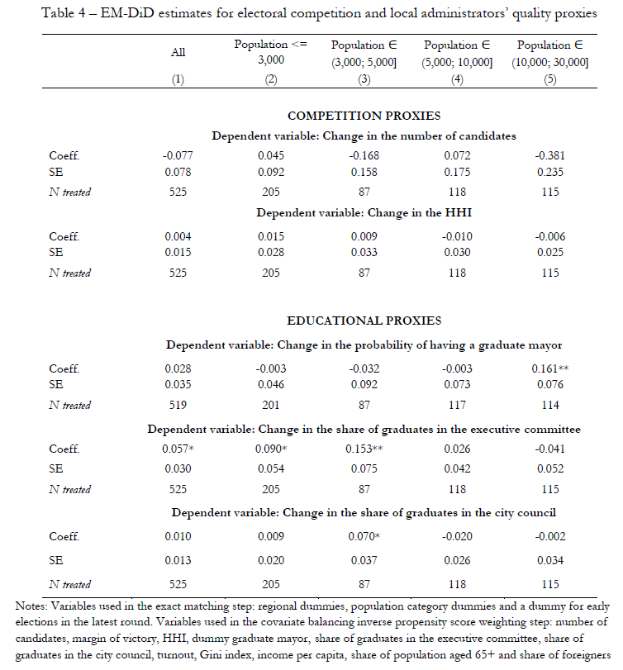
EM-DID results
Null results (and small magnitude) on competition
Positive effects on executive committee (assessori)
Cerqua, Nocito & Pinto
Money talks: the effect of a pay rise on local politicians’ quality

Slide 30
Other outcomes
Occupation of candidates - blue/white collar - other classifications (no effect)
Heterogeneity (e.g. by party, external ex. committee,…no effect)
Cerqua, Nocito & Pinto
Money talks: the effect of a pay rise on local politicians’ quality

Slide 31
mechanism
Ideally, we can divide post-reform mayor candidates into two possible categories:
Cerqua, Nocito & Pinto
Money talks: the effect of a pay rise on local politicians’ quality

Slide 32
mechanism
Ideally, we can divide post-reform mayor candidates into two possible categories:
the "always-candidates", who would run for the election anyway and independently from the introduction of the reform (i.e., a pay rise);
Cerqua, Nocito & Pinto
Money talks: the effect of a pay rise on local politicians’ quality

Slide 33
mechanism
Ideally, we can divide post-reform mayor candidates into two possible categories:
the "always-candidates", who would run for the election anyway and independently from the introduction of the reform (i.e., a pay rise);
the "comply-candidates" who would run for the election given the pay rise, and they would not otherwise.
Cerqua, Nocito & Pinto
Money talks: the effect of a pay rise on local politicians’ quality

Slide 34
mechanism
Ideally, we can divide post-reform mayor candidates into two possible categories:
the "always-candidates", who would run for the election anyway and independently from the introduction of the reform (i.e., a pay rise);
the "comply-candidates" who would run for the election given the pay rise, and they would not otherwise.
In such a short time period (6 months) is hard for "comply-candidates" to enter the political market and run for the election.
Cerqua, Nocito & Pinto
Money talks: the effect of a pay rise on local politicians’ quality

Slide 35

What we have not yet done..
so far we have dealt with outcomes concerning the selection of politicians (Do higher wages attract different politicians?)
In the future, we plan to look at the intensive margin (Do better paid politicians work more-and- better?)
  Issues
    We need to wait because the reform has just been adopted…
    We are looking for new measures that specifically capture politicians behaviour (e.g. not confounded by bureaucrats…)
    We are working on National Recovery Plan funds that depends on mayor impulse
Cerqua, Nocito & Pinto
Money talks: the effect of a pay rise on local politicians’ quality

Slide 36

gabriele.pinto@uniroma1.it

Slide 37
This is preliminary, any comment is more than welcome. Thanks!
gabriele.pinto@uniroma1.it

Slide 38
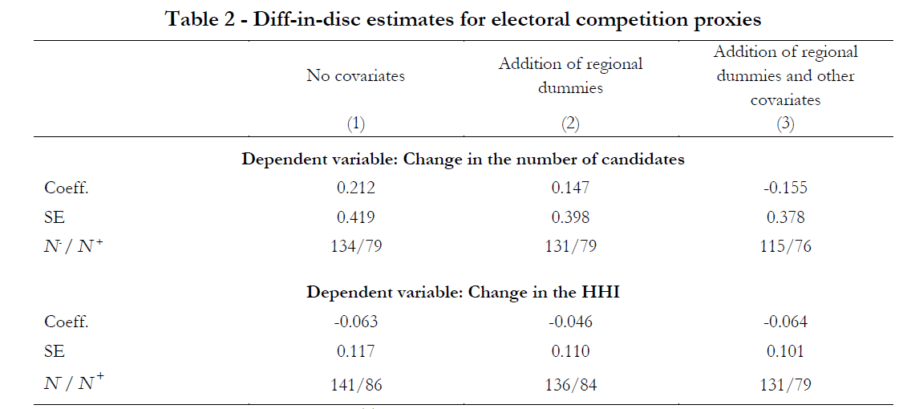
Appendix

Slide 39
Appendix

Slide 40
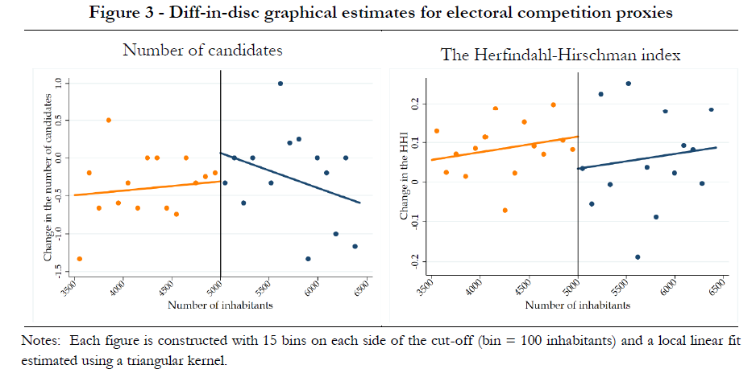
Appendix

Slide 41
Notes
Notes: All estimates are robust bias-corrected. The bandwidths for each non-parametric local linear regression are selected using the optimal data‐driven method as per Calonico et al. (2019). By using a data-driven bandwidth selection, we obtain different bandwidths for each analysis. N− and N+ denote the number of municipalities within the bandwidth below and above the threshold, respectively. The control variables included in column (3) are: a dummy for early elections in 2022, income per capita, Gini index, share of population aged 65+, share of foreigners, turnout and a dummy for early elections. ***p<0.01, **p<0.05, *p<0.1.

