Slide 1
If the plumber and the doctor are expected to know their profession, is it not appropriate to ask someone who has to perform a more socially important task, such as that of a member of parliament or the executive, to have a certain degree of competence?
Sabino Cassese
Former president of the Italian Constitutional Court
(from the Preface of Against Democracy – J. Brennan)

Slide 2



What characteristics of politicians affect electoral success? Estimates from a new dataset of candidates’ CV
Gabriele Pinto
PhD Student, Department of Social Science and Economics, Sapienza University
Società Italiana di Economia
62ª Riunione Scientifica Annuale - online - 26-29 ottobre 2021

Slide 3
Research question
Education, Gender, Political Experience, Presence on the web
What characteristics of politicians affect….
electoral success? ….
….Estimates from a new dataset of candidates’ CV
Number of preference votes
Candidates for the European Elections of 2019 in Italy

Slide 4


Let’s do a little game

Slide 5
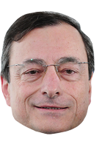

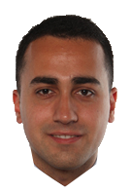




Curriculum Vitae
Name: Mario Draghi
Name : Luigi Di Maio
At the age of 18 he attended the faculty of Economics at La Sapienza (Rome) and get a degree.
At the age of 24, he enters the PhD programme of economics at MIT (Boston).
At the age of 30 he gets his PhD from MIT and start to work as a professor at various Universities and Public institutions (Ministries and Central Banks)
….
….
….
….
…..
At the age of 74, after 40 years of brilliant career in Ministries , Banks, and Central banks he becomes Prime Minister.
At the age of 18 he attended the faculty of computer engineering for a few months. After, he moves to the faculty of Law (Naples). He never graduated from the university.
At the age of 20, he enrolled as a freelance journalist with the National Order of journalists. Later, he briefly worked as a webmaster and as a drinks seller at the Stadium.
At the age of 26 he his elected at the Parliament and becomes the youngest vice president of the Parliament.
At the age of 32 he becomes contemporarily 1) Ministry of Economic Development 2) Ministry of Labour and Social Policies and 3) deputy prime minister.
At the age of 33 he becomes Ministry of Foreign affairs.
Notes:
Let’s try to solve this quiz.
TAKEWAY
It is fair to say that given these two examples, If one would aim to have a government role in the fastest way, HE/SHE should not:
-get a degree at the university
-get a PhD in Boston
-working at public institutions

Slide 6
Individual Characteristics
What we know from the literature?

Slide 7
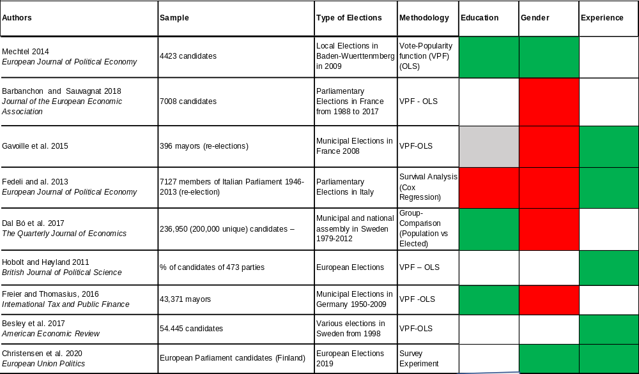
The literature: Individual Characteristics
NEGATIVE
POSITIVE
Any limitations?
NOT ANALYZED
NOT SIGNIFICANT

Slide 8

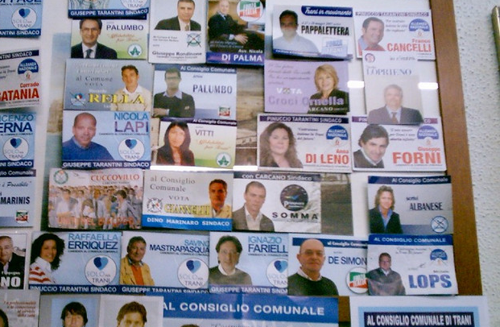

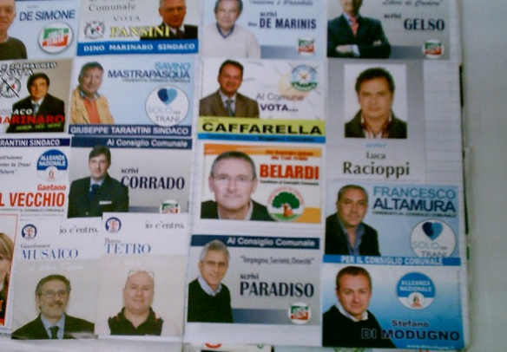

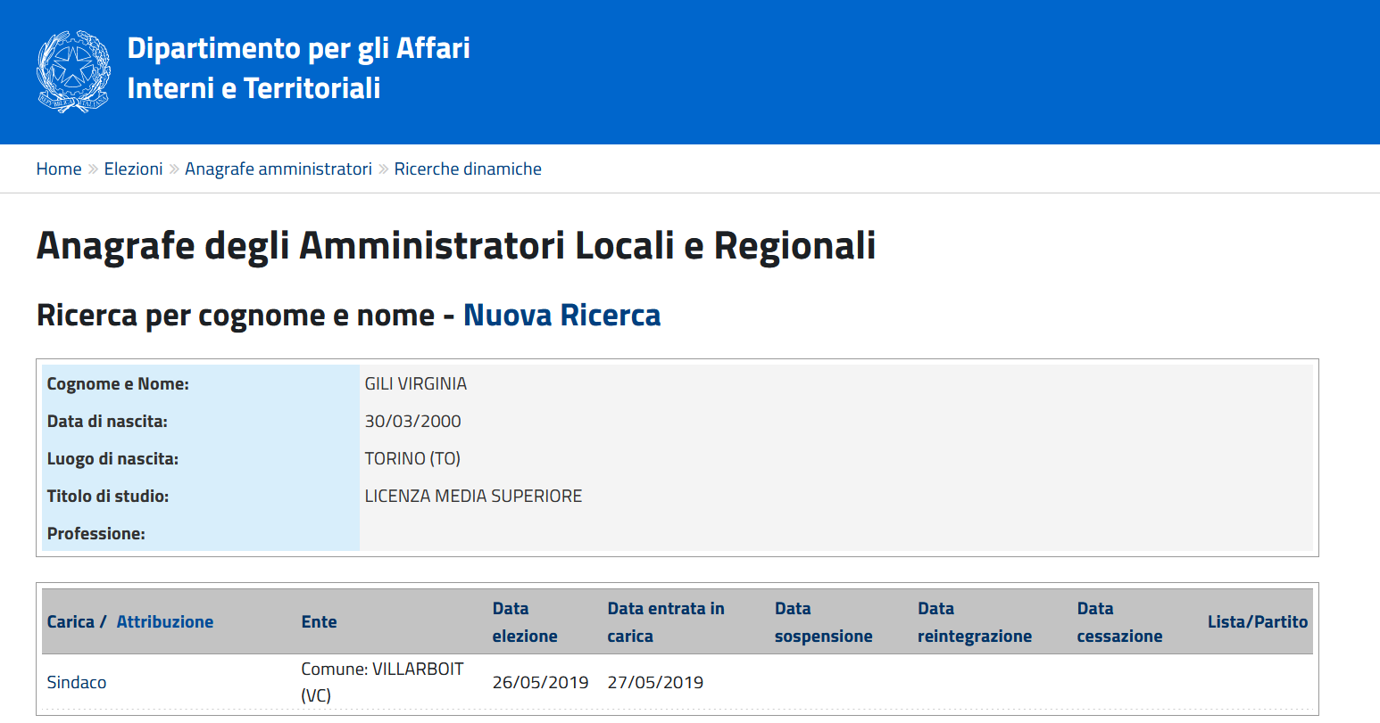
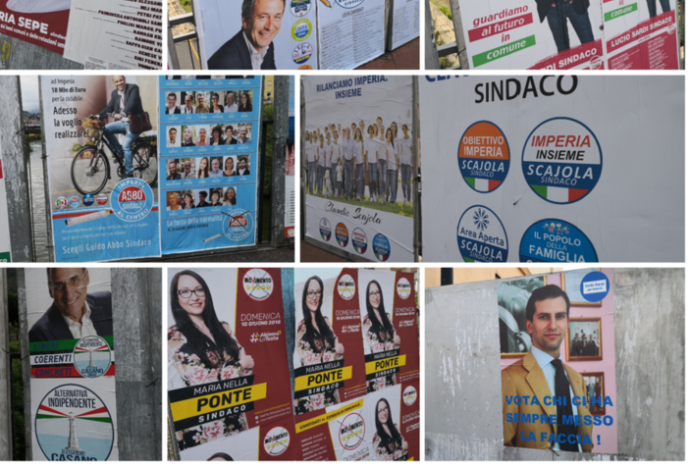
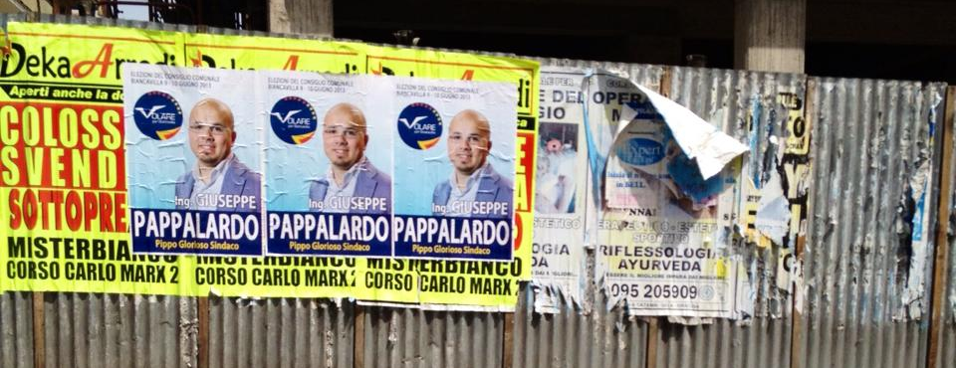
Two Main limitations
First limitation: Selection Bias (bulk of studies only analyses Elected Politicians)
what about all the other non-elected candidates?

Slide 9


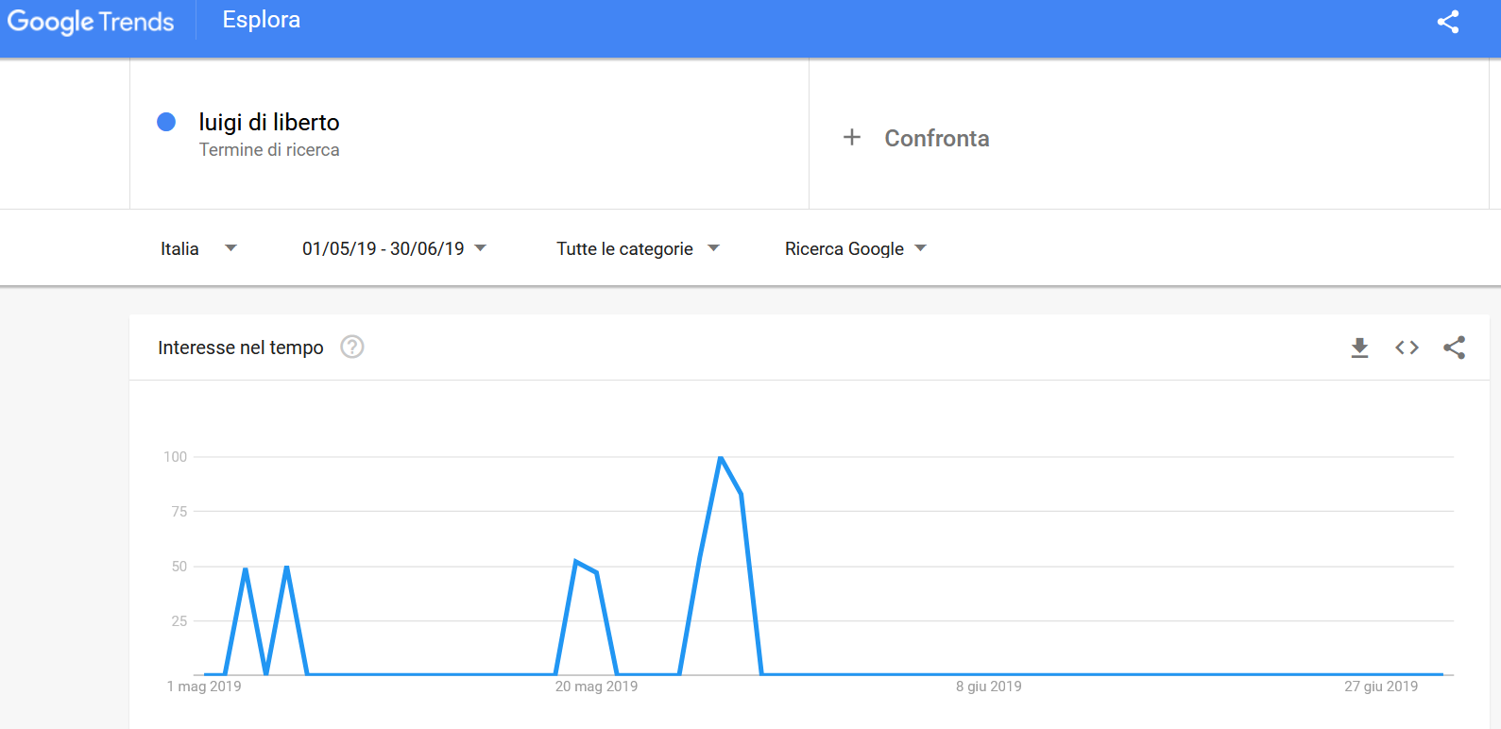
Two Main limitations
2.Second limitation: Omission of “new” factors (e.g. presence in the social media).

Slide 10
Main Contributions
  A new dataset with information about 1076 candidates for the European Elections of 2019
    Previous analysis use administrative dataset comprising only winning candidates (selection bias).
    This dataset also includes information about non-winning candidates.
    Also includes novel information (social media presence)
    Un-structured data (text of the curriculum)
  Re-assessing standard hypothesis of characteristics that affect electoral success of candidates.
      Gender
      Education
      Experience
      Presence on social media

Slide 11
Main Results
What characteristics of politicians affect electoral success?
ceteris paribus…
Having a previous important political experience
Being active on social media
Being on a top-position on the list
Having a university degree
Being woman
Having a “too-high” education (PhD)
Being young

Slide 12
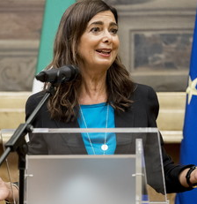
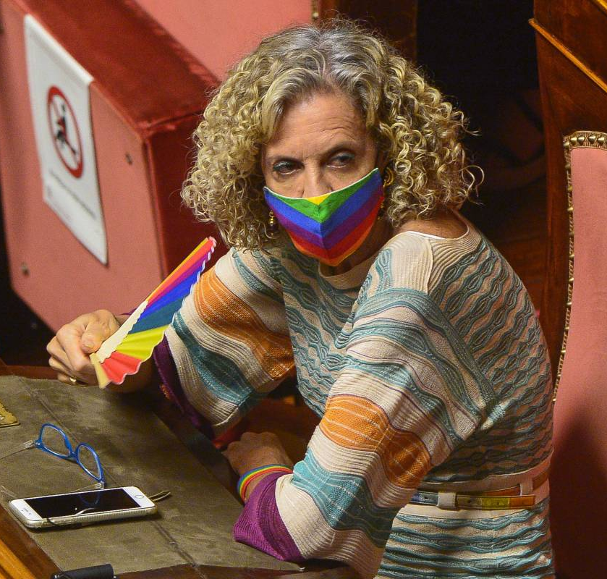
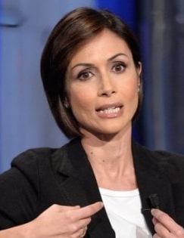
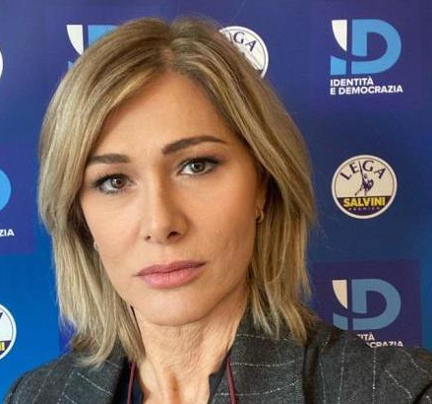
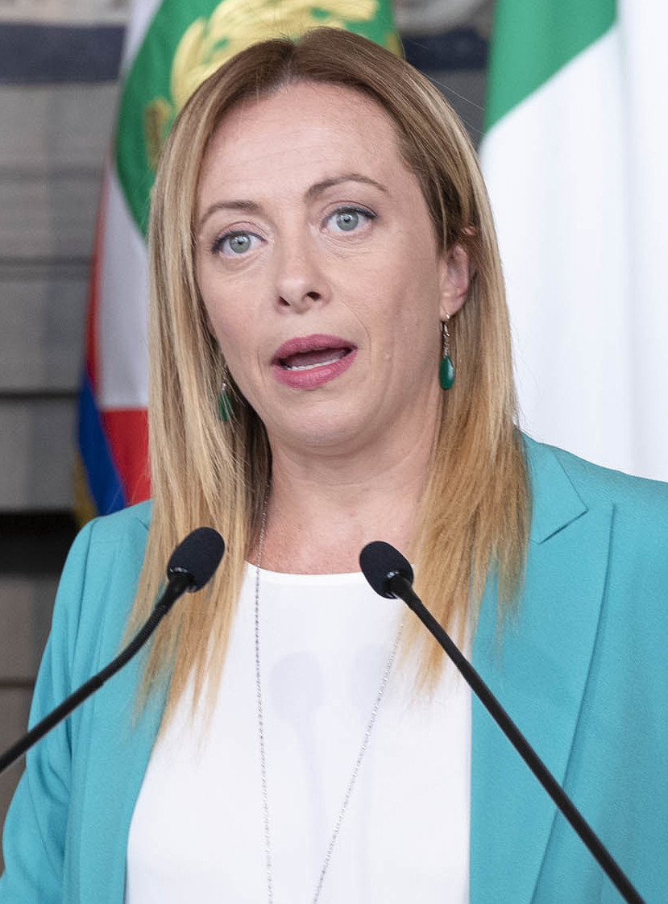
Additional Results
How does the effect changes among parties ?
Is discrimination against women or educated candidates more relevant in some parties compared to others ?
We will see it later…

Slide 13
Programma presentazione
t
Context
The Dataset
Empirical Results

Slide 14
Why Economists should be interested into this question ?
All Politicians are the same !
To improve politics, it is necessary to improve or reform rules, the framework within which the game of politics is played. There is no suggestion that improvement in politics lies in the selection of morally superior agents
James Buchannan, The public choice Perspective, 1989
Almost every major episode of economic change over the past 200 years of political history has been associated with key personalities coming to power with a commitment to these changes. How those personalities are selected ? Who become politicians ?
it is essential to understand how political selection works.
Timothy Besley, Journal of Economic Perspectives, 2005
All Politicians are NOT the same !
Notes:
This is the first reason why this should be interesting

Slide 15
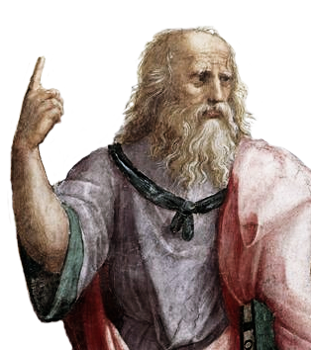
Having good politicians is a primary objective of democracies
What about women?
"philosophers [must] become kings…or those now called kings [must]…genuinely and adequately philosophize" (Plato The Republic, 5.473d).
“The aim of every political Constitution, is or ought to be, first to obtain for rulers men who possess most wisdom to discern, and most virtue to pursue, the common good of society; and in the next place, to take the most effectual precautions for keeping them virtuous whilst they continue to hold their public trust.”
Maddison, Federalist papers 57# (17 Febbraio 1788)
WISDOM = «competenza», «saggezza» , «sapere»
Notes:
Second reason

Slide 16
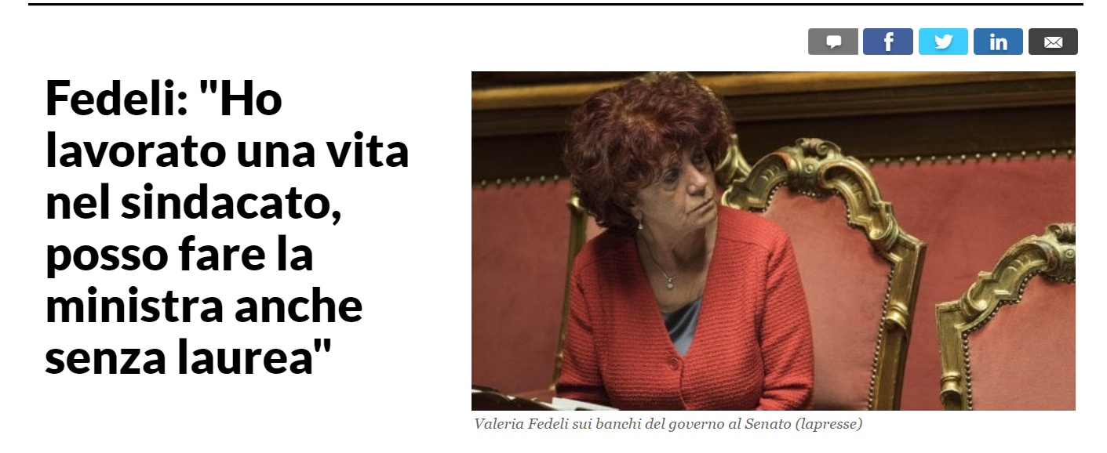
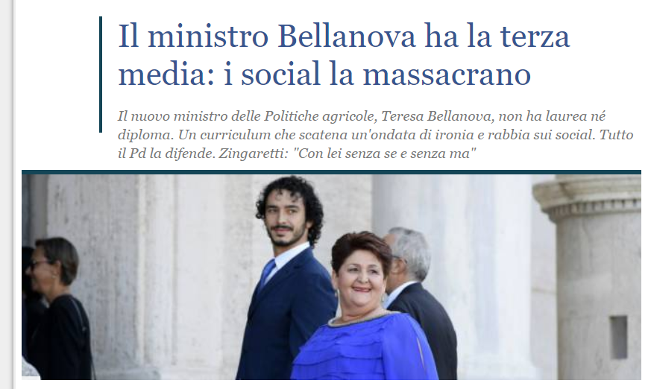
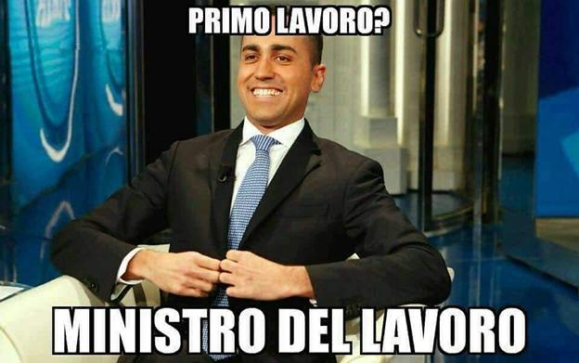
Public opinion appear to be very sensitive to the argument….
But… How does this sensitivity translates into the ballot box ?
Notes:
Third reason

Slide 17
Programma presentazione
t
Context
The Dataset
Empirical Results

Slide 18
THE DATASET

Slide 19
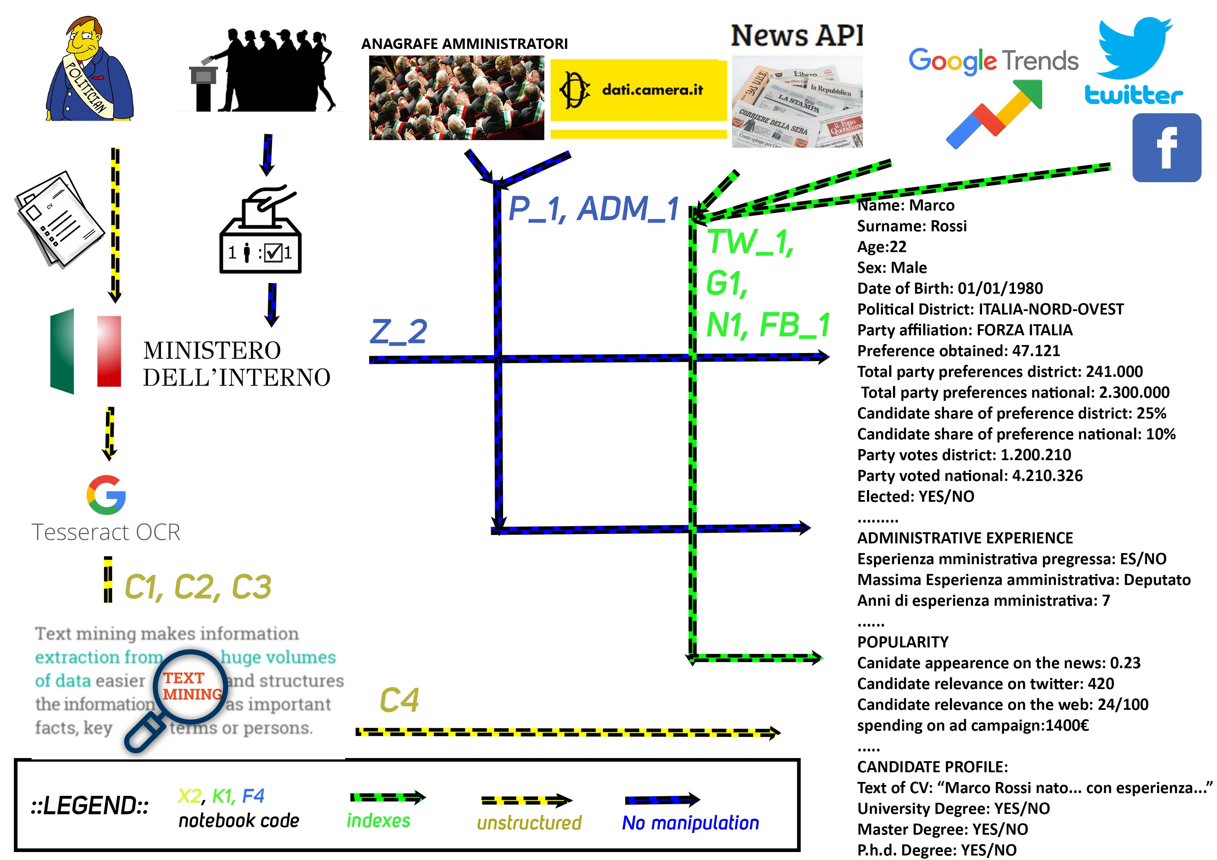
Dataset

Slide 20
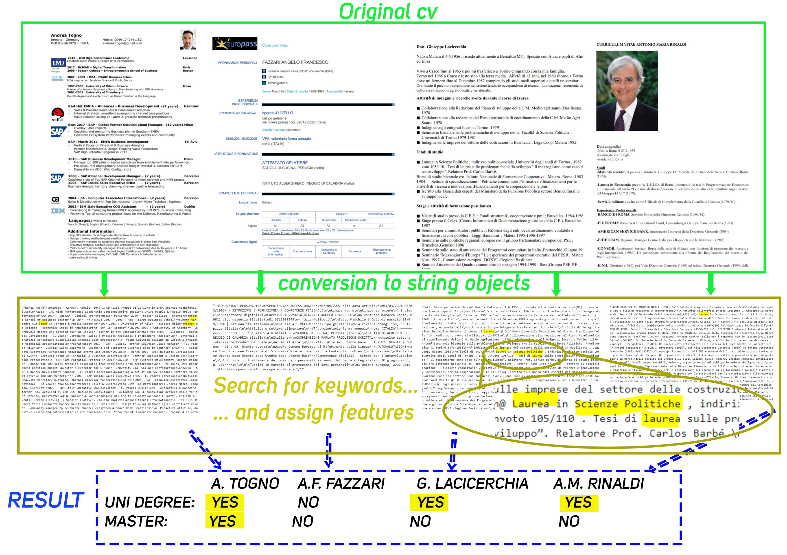
Text mining

Slide 21
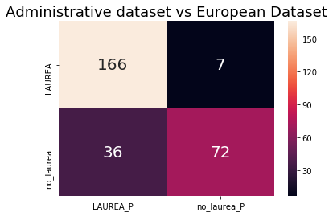
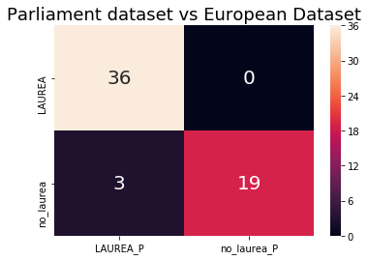

Validation
For some candidates we also have information on administrative dataset. Using these candidates we can validate our text-mining procedure.

Slide 22
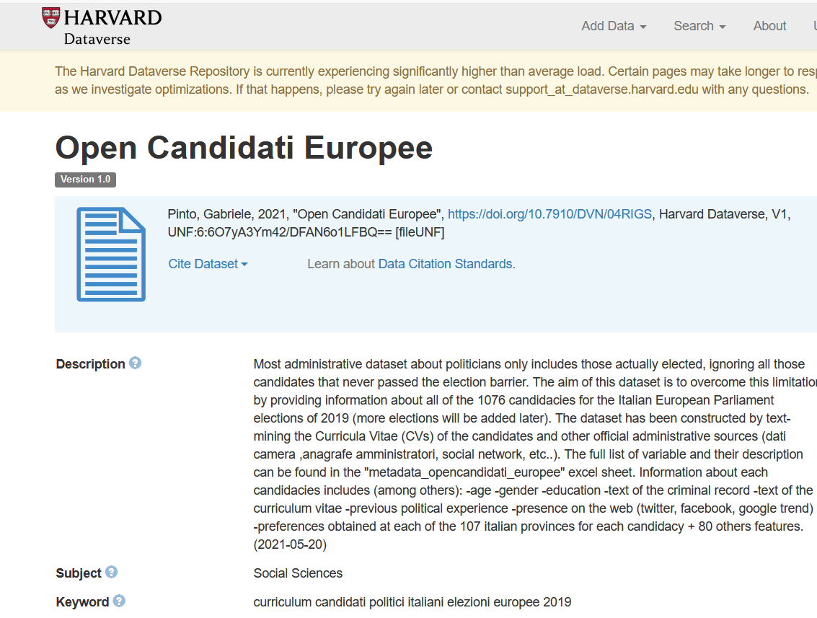

All the scripts and the full dataset are made public on harvard dataverse and github

Slide 23
Programma presentazione
t
Context
The Dataset
Empirical Results

Slide 24
Vote Popularity Function
Preferences obtained by candidate c in province p
(% of the list)
Political Experience
Number of Previous Political Experience
,p
,p
Position in the list
Other controls
Province and party fix effects, age, gender, etc..
Education
Dummy for a degree or a PhD
Presence on the web
-Google trend (cumulative over two months)
-Twitter (Number of retweets)
- Facebook ads budget
Problem : Can we assume that E(u|X)=0 ?? Endogeneity issues (es: income/wealth of candidates).
Solution: We try to control for a range number of factors and we run several robustness test.
NO CLAIM OF CAUSALITY

Slide 25
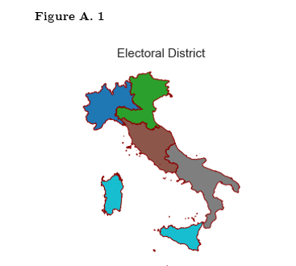
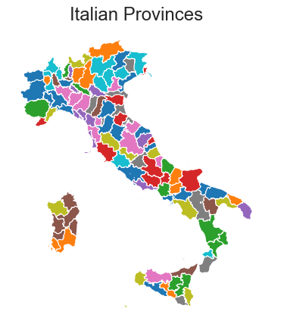

Ruling out supply side effects - 1

Slide 26
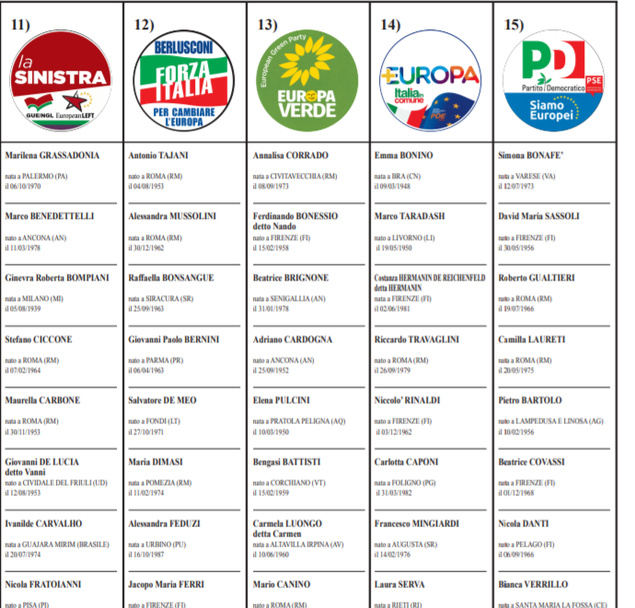
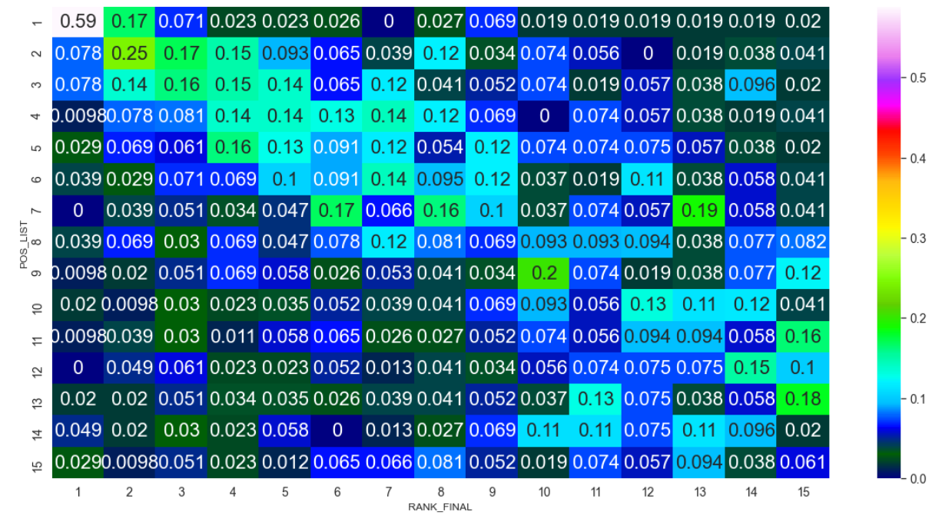
Ruling out supply side effects - 2
CONTROLLING FOR POSITION IN THE LIST!
Notes:
Disentangling predicting component from unexpected component

Slide 27
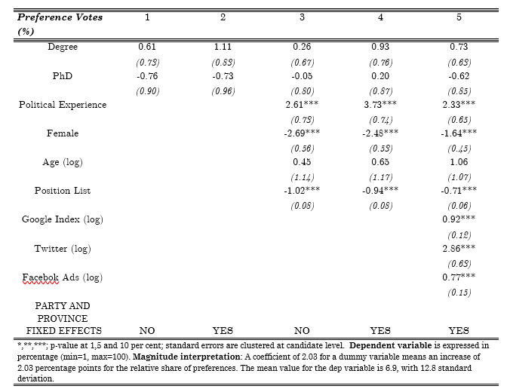
Results - Table

Slide 28
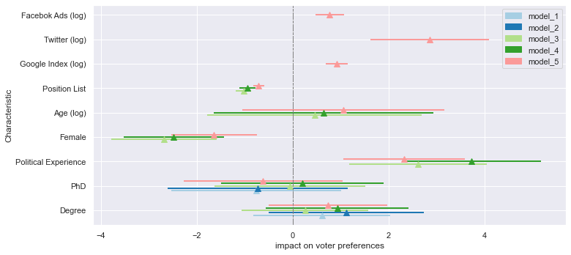





Results - Plot

Slide 29
Results - Table
What happen when we include Presence in the social media ?
Including presence in the media reduces the size of:
  Negative effect of being woman
  Positive effect of being educated
  Positive effect of having political experience
amplifies the size of:
  Being too much educated (PhD)
  Being young

Slide 30
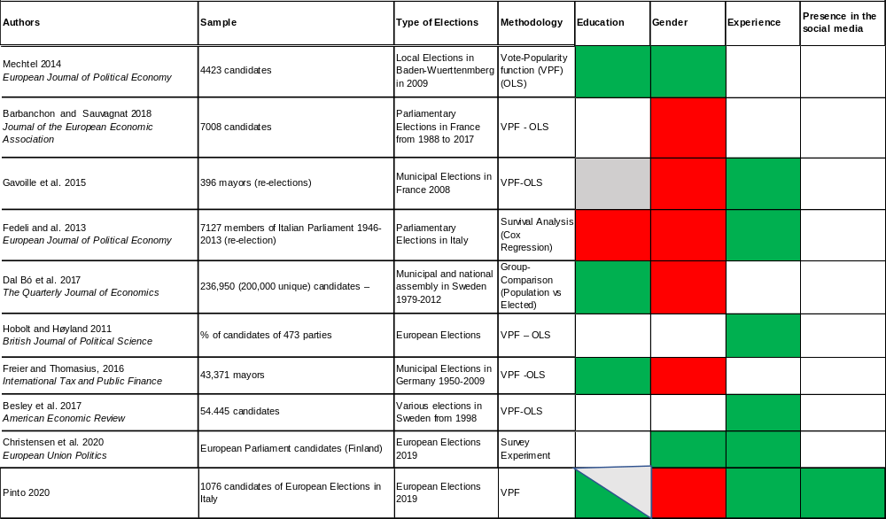
The literature: Individual Characteristics
NEGATIVE
POSITIVE
NOT ANALYZED
NOT SIGNIFICANT

Slide 31
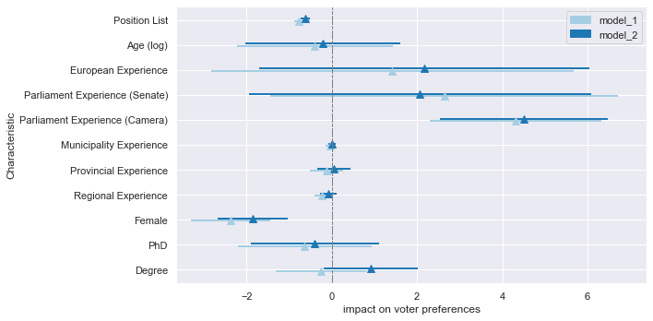
Results – Additional Evidence on experience

Slide 32
Robustness test
In the appendix of the paper:
  Alternative dependent variable (Position change between ballot position and final results as in Mechtel 2014)
  Excluding “champions” and “loosers” (top/bottom 95th percentile)

Slide 33
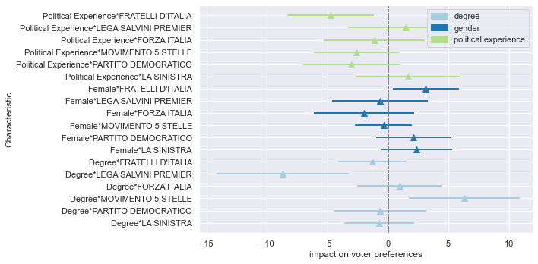
How does the effect vary among parties ?

Slide 34
SELECTION BIAS
One of the main novelty of this database is that we only look also at non-elected politicians ?
But how much is the selection bias relevant ?
SOLUTION:
  Estimate separate models with full-sample and “only elected” (75 candidates) sample

Slide 35
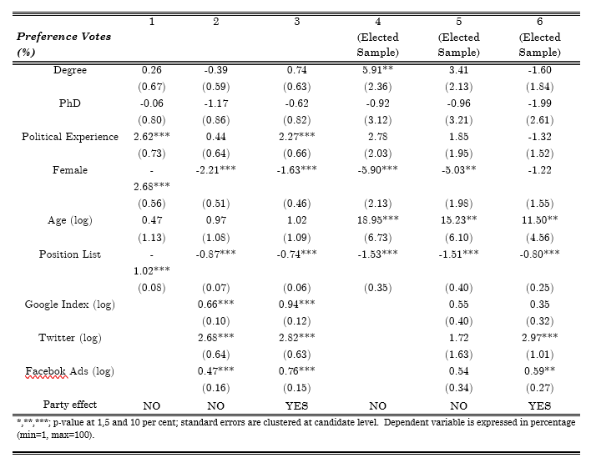
SELECTION BIAS

Slide 36
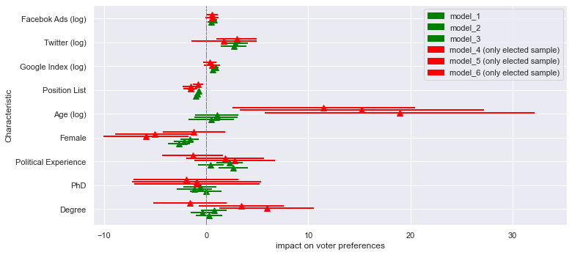
SELECTION BIAS

Slide 37
PREDICTIONS – MACHINE LEARNING
OLS model have the great advantage of being easily interpretable. We can interpret the sign and the size of each character and their relationship – ceteris paribus – with the electoral success of the candidate.
However, the advantage of interpretability comes with the cost of not being able to capture interactions and non-linear relationships.

Slide 38
PREDICTIONS – MACHINE LEARNING
Alternative approach:
Machine Learning
we move our lenses from inference, to prediction (e.g. predicting electoral results)
We estimate a battery of the most popular models (LASSO, RIDGE, RANDOM FOREST, NEURAL NETWORKS)… over 100 random train/test split (to test for significance)… and compare results.

Slide 39
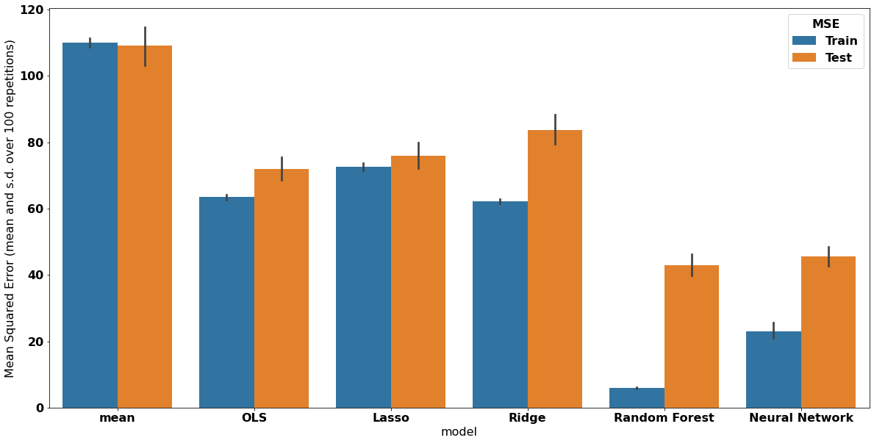
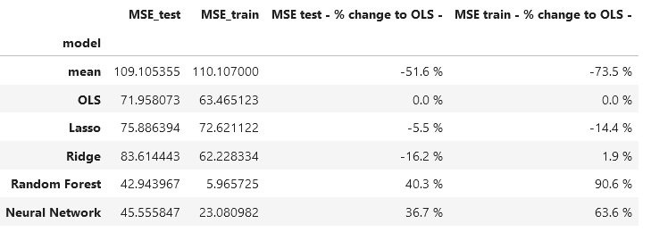
PREDICTIONS
+40%
=improvements=

Slide 40
PREDICTIONS
IMPLICATIONS:
-While previous studies have showed the potential and limitations of usage of internet and social network data for predicting elections with ML models (Gayo-Avello and al. 2011, Schoen et al. 2013, Tsakalidis et al. 2015, Skoric et al. 2020), this is the first attempt that combine these types of data with actual individual characteristics of politicians (with nice results)
LIMITATIONS:
Small N
Data leakage ? (party fix-effect)
Need to replicate for various round of elections

Slide 41
Summing up
Having a Master/Bachelor degree has a positive/null effect
Having a PhD has a negative/null effect
Having a strong political experience has a positive effect
Being woman as a negative effect
Including presence in the media
  reduces the size of:
      Negative effect of being woman
      Positive effect of being educated
      Positive effect of having political experience
  amplifies the size of:
      Being too much educated (PhD)
      Being young

Slide 42
Summing up the relationships
women
Left-wing
Electoral Success
education
Right-wing
Political experience
Popular on web

Slide 43
Limitations
Descriptive realm… we control for a lot of factors but still difficult to claim any causality
Do these attributes really matters in the political discussion ?
Why more educated/experienced politicians have more success ? It is because of political rents or because of appreciation by voters?
What do voters know and value about politicians?

Slide 44

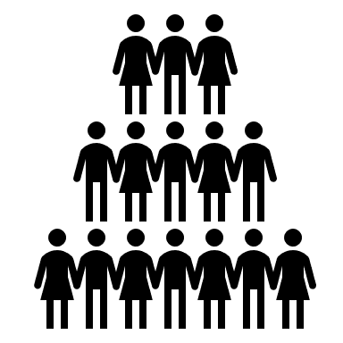
Future research
A randomized experiment to evaluate if voters care about those characteristics and how much they value them.
We give them information about politicians
(education, experience, etc…)
VOTE Y
?
treatment
VOTE X
control

Slide 45
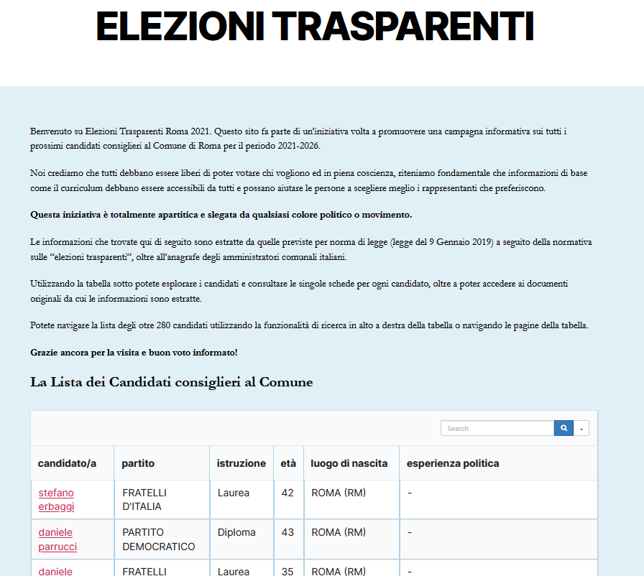
Future research
www.elezionitrasparentiroma.it

Slide 46

Future research
The experiment is running right now! We will analyse the results in the following months

Slide 47
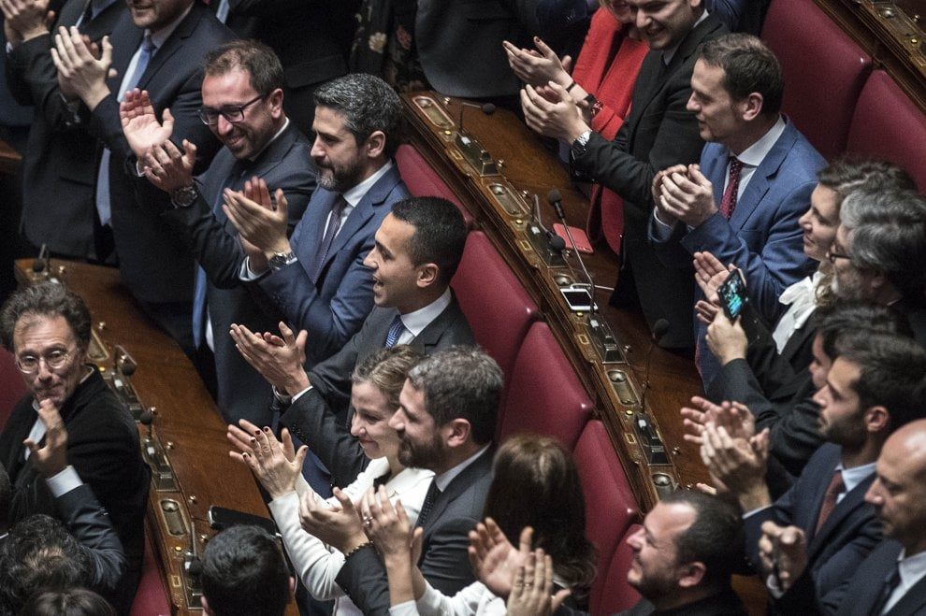
Thanks for your attention! Feedbacks, critics and proposals are welcome!
gabrielepinto.com gabriele.pinto@uniroma1.it

Slide 48

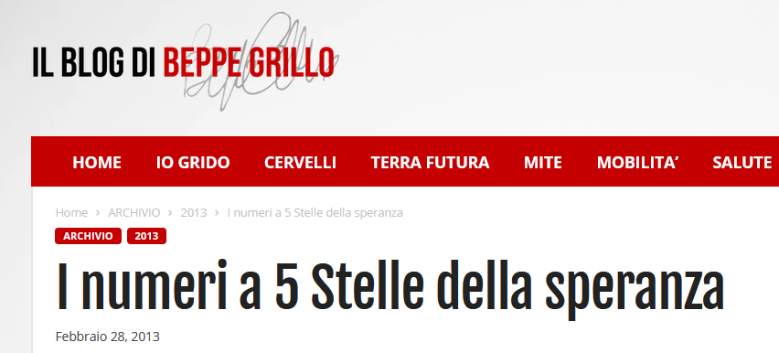
Parties cares about competence…
Statuto del Partito Democratico, Articolo 25, comma f
il principio del merito che assicuri la selezione di candidati competenti, anche in relazione ai diversi ambiti dell’attività parlamentare e alle precedenti esperienze svolte;
"la forza politica in Parlamento con il più alto numero di donne e laureati» Riccardo Fraccaro
«La nostra forza politica ha un gruppo parlamentare che è il primo gruppo parlamentare per laureati di tutto il Parlamento».
Luigi Di Maio
Notes:
Third reason

Slide 49
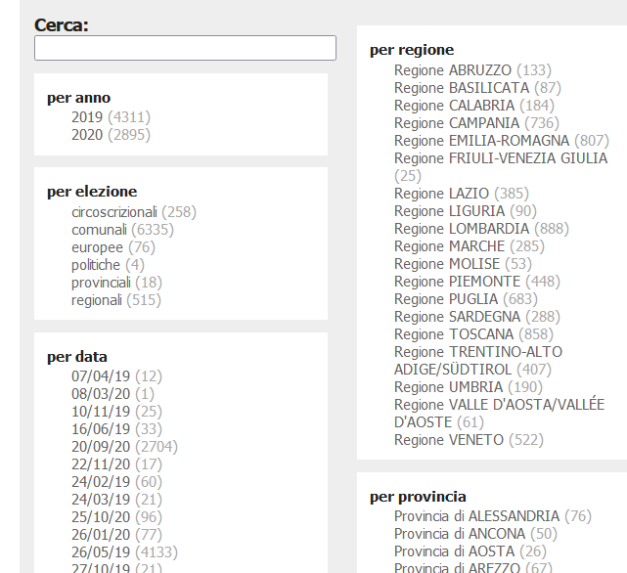
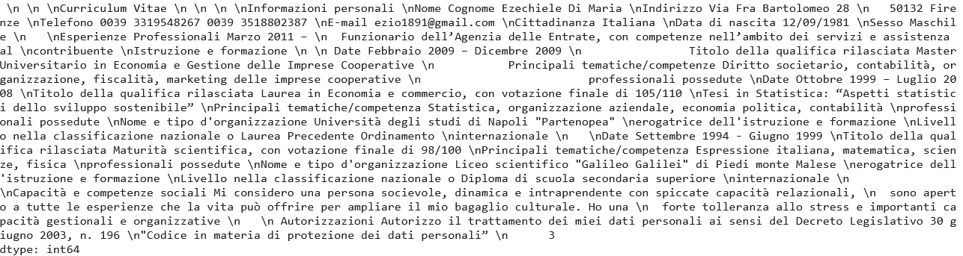
Current and Future Research
A dataset with more than 50k curriculum of candidate politicians.
What we can do with all this text?
How can we extract value from this information ?
Features extraction:
  Alma mater
  Working place
  Organizations
Topic modelling
Network Analysis, others???
Build a dedicated search engine
Suppose a journalist wants to find politicians that are related to a certain firm, by writing the name of the firm, they may inspect if that name appears in the curriculum of some politicians.

Slide 50
Summary stats
Figure 5: Example of Ballot list poster. (European Elections 2019)

Slide 51
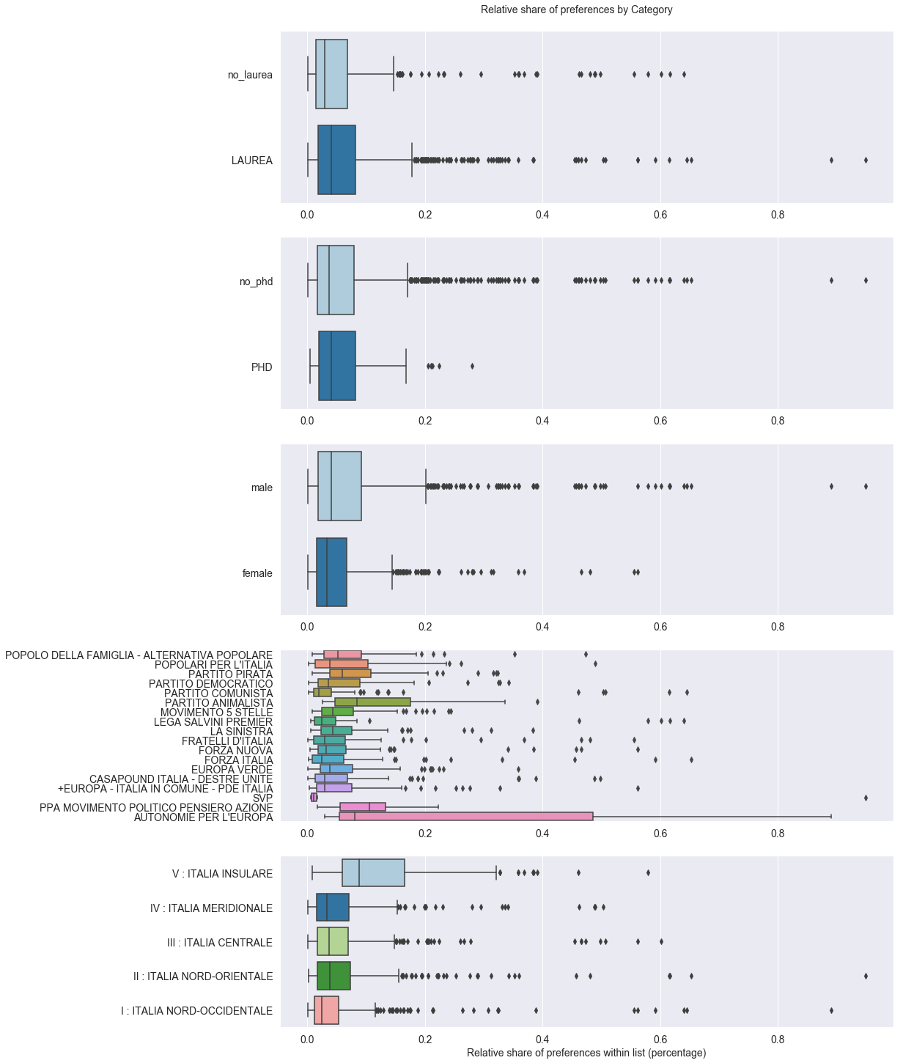




Summary stats
LAUREA
PHD
SEX

Slide 52


Summary stats

Slide 53
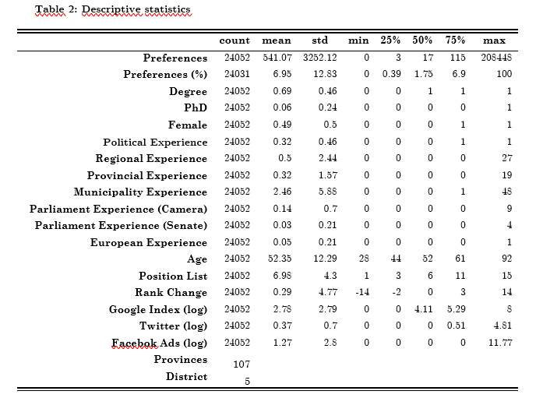
APPENDIX – Summary statistics

Slide 54
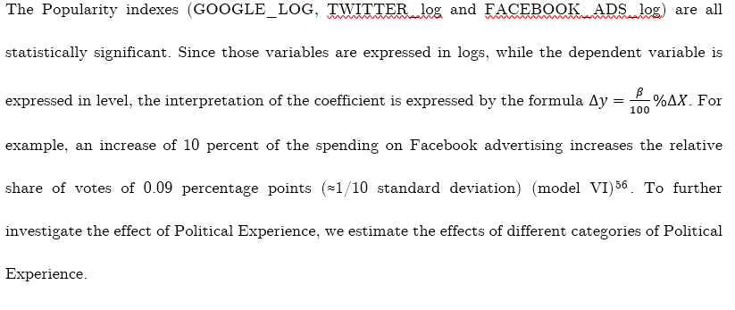

APPENDIX - Interpretation magnitude level-log

Slide 55
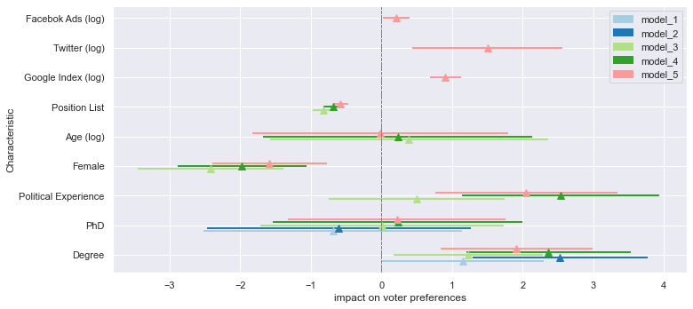
APPENDIX – Excluding top and bottom 5th percentile

Slide 56
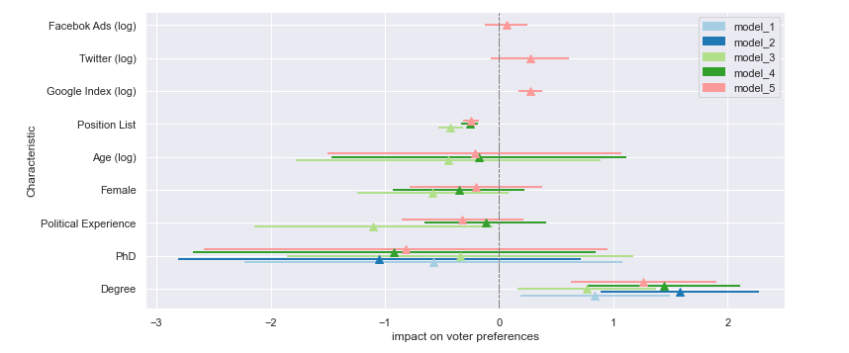
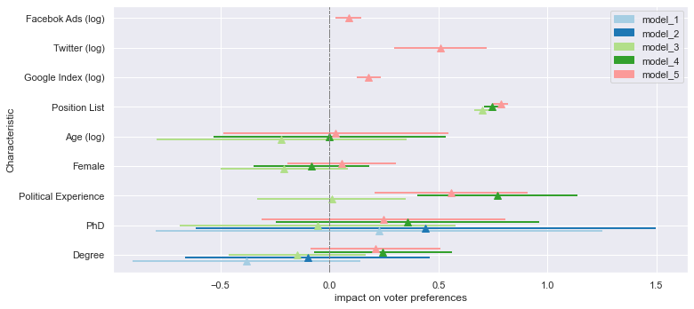
APPENDIX – Alternative dep. Variable (Rank Change)

Slide 57
APPENDIX – excluding Giorgia meloni

Slide 58
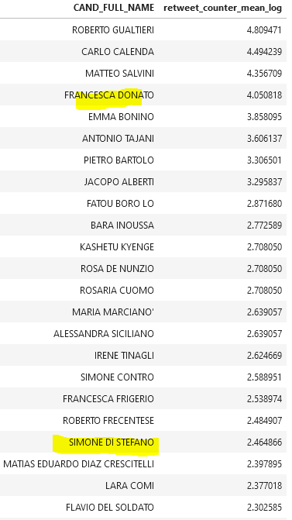
Twitter top performer

Slide 59
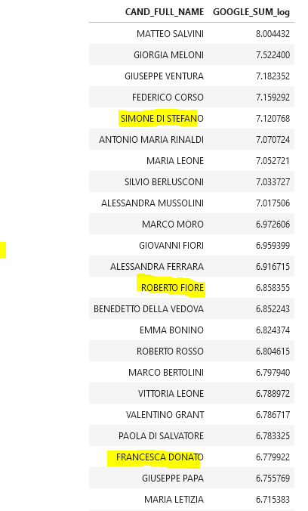
Google top performer

